Slide 1
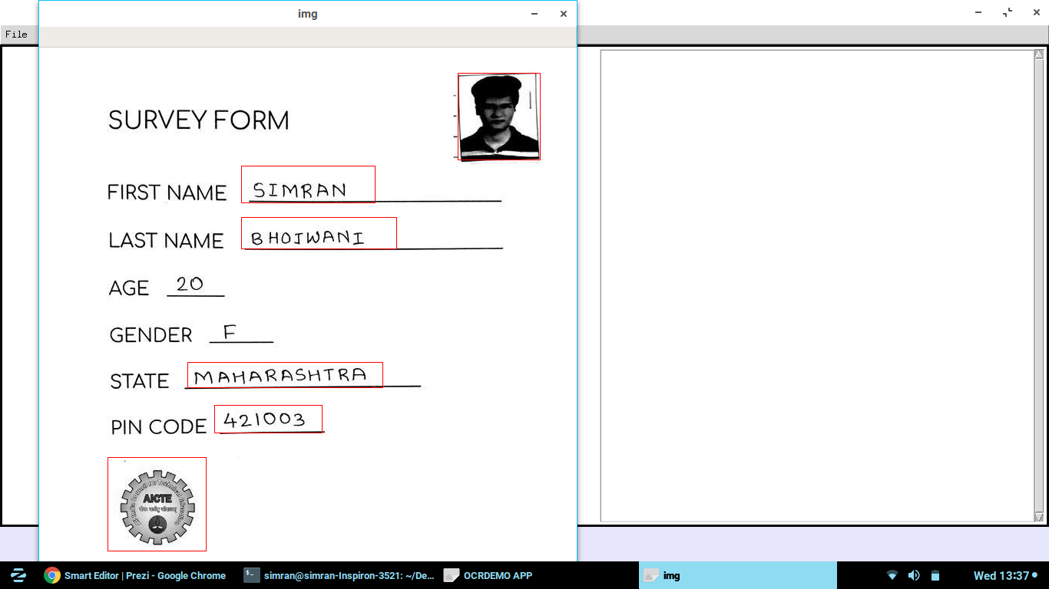
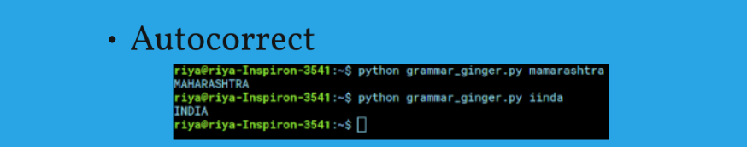
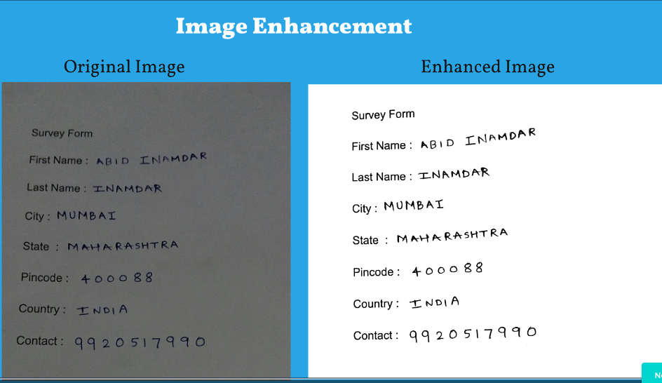
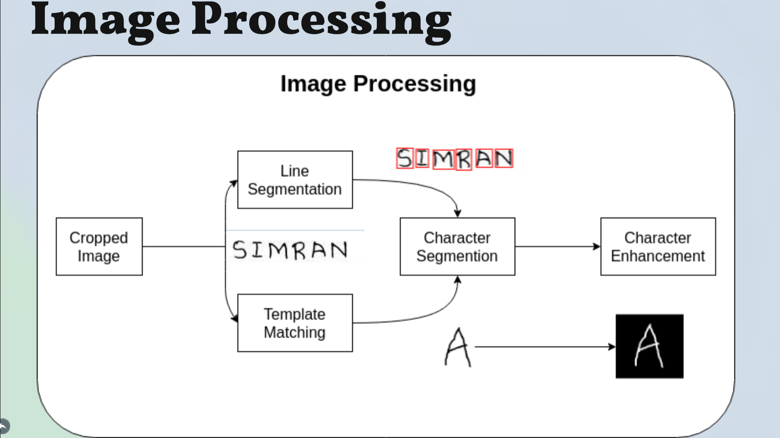
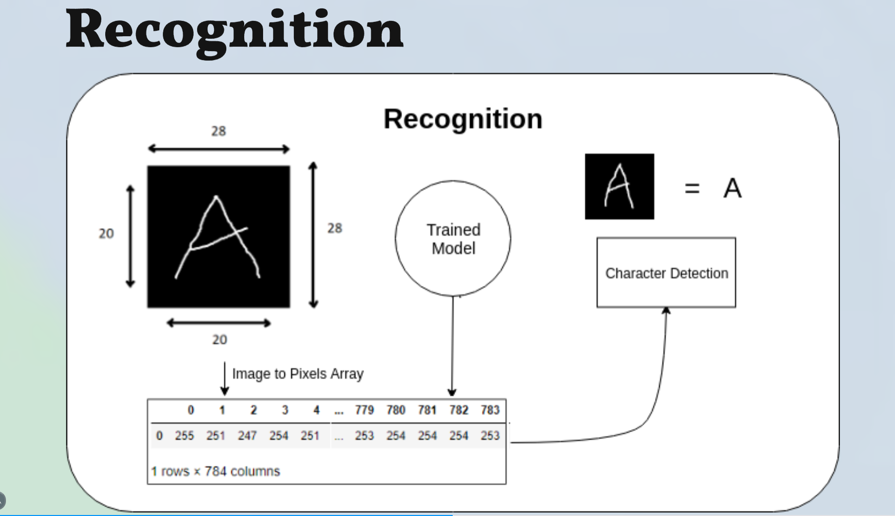
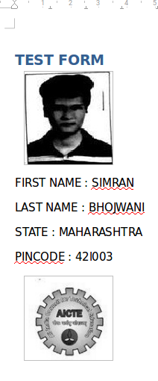
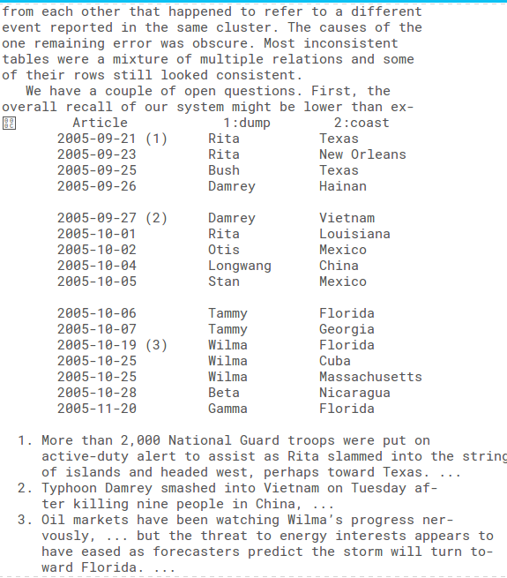
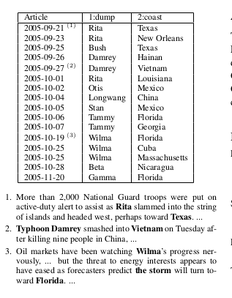
University Research Convention Avishkar 2018-19
Category and Level : C/5, UG
Smart Editor
Problem Statement
Template Generation
Enhancements
A tool for fetching and editing information from a document mainly of image type
Need ?
Unnecessary wastage of Human Resources, Time, Money
Solution
Scan document
Choose template
Obtain in editable format
Architecture
Working
Features
Tech Stack
Image Processing : OpenCV, Python
Training Model : Keras
Desktop GUI : Tkinter
Conclusion
With this editor various government organisations can convert the huge amount existing paper based data into digital one. Thus saving lot of time and human effort.

